Slide 1
Security Access With Deep Learning
CAO LIANG | A0012884E
GENG LIANGYU | A0195278M
HAN DONGCHOU FRANCIS | A0195414A
ONG BOON PING | A0195172B
TAN CHIN GEE | A0195296M

Slide 2
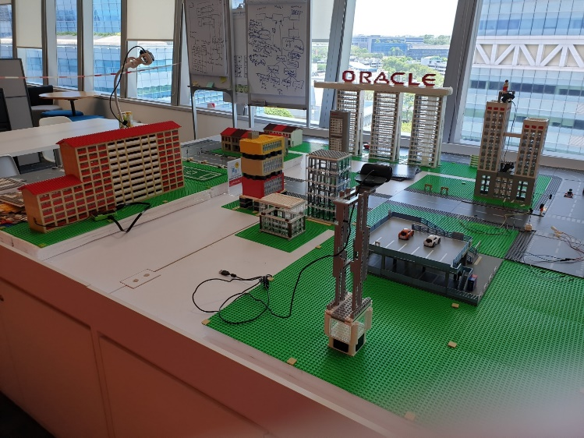
Problem Statement
Lobby Area
Secure this public Demo Area so that demo asset can be protected.
We will not be able to use physical partition because of esthetic issues.
Hence we will need a way to secure the area without any obvious physical barriers or devices.
Demo Asset

Slide 3

Solution Overview – Key Components
Intruder Detection
3
1
Face Recognition
2
Alert Mechanism
2
Pole & Rope
1
Demo Asset

Slide 4
Solution Overview – How it Works
When an intruder enters the prohibited zone, camera 1 detects the presence and initiates the process for camera 2 to start the face recognition.
The face recognition algorithm determines whether the person is an authorized employee. If yes, his presence is logged in the audit trail. If not, then alert activation will take place.
Alert will be sent via email with attachment of intruder’s picture. An SMS will be sent to a stakeholder. Also, the incident will be logged.
2
1

Slide 5
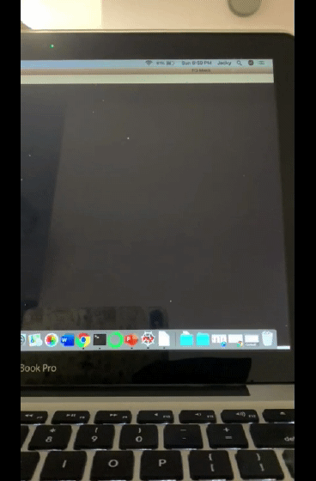
Detect Intruders by Background Subtraction
Detect movement in webcam video through the Background Subtraction method. Any detected movement will be display in white against a black background.
Background Initialisation – compute initial model of background
Read the video stream images sequence
Generate the foreground mask
Background Update – update model to adapt to possible changes Each frame calculates foreground mask and updates background
Results of the updated video stream is displayed
Model = Gaussian mixture model
Output of Background Subtraction
Notes:
Overview: Detect movement in webcam video through the Background Subtraction method. Any detected movement will be display in white against a black background.
Background Initialization – compute an initial model of the background
Generate the foreground mask using the cv::BackgroundSubtractor object
Read the video stream images sequence using the cv::VideoCapture
Background Update – update model in order to adapt to possible changes in the scene
Each frame currently calculate the foreground mask and updating the background
Results of the updated video stream is displayed
Model = Gaussian mixture model
Background Subtraction triggers Face Recognition by - black area (i.e., values of 0) < 98% (adjustable threshold)
Reference: Z.Zivkovic, Improved adaptive Gaussian mixture model for background subtraction, International Conference Pattern Recognition, UK, August, 2004, http://www.zoranz.net/Publications/zivkovic2004ICPR.pdf

Slide 6
Face Recognition Solution Framework
Face Detection
Bounding +
Feature Extraction
Ensemble
Haar Face Cascade
Video Stream
OpenCV
Face Alignment
Face Detection + Face Alignment
KNN
MTCNN
Logistic Regression
Voting
Prediction
Face Representation
Refining + Encoding with 128 Feature Vectors
SVM
Dlib
face_recognition
MLP

Slide 7
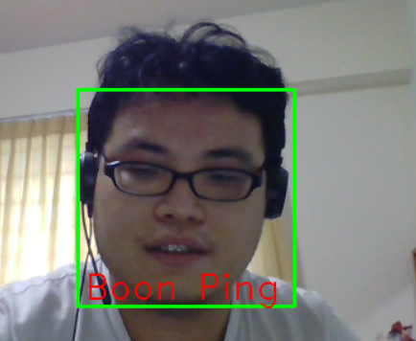
Samples Used
100+ Samples
Augmentation
Change lighting by changing gamma to 0.8/1.2
Images are filtered using Laplacian of Gaussian
Images are filtered with Gaussian Blur
Images are zoomed in or zoomed out
Images are rotated right or left up to 15 degree
Images are flipped horizontally
100K Samples

Slide 8
OpenCV – Haar Cascade
Haar Cascade has 4 stages:
Haar Feature Selection (Not Haar Wavelet)
Creating Integral Images (Allows multiple Haar features to be determined across the image)
Adaboost Training (Boosting method, ensemble on weaker convolutional classifier using Haar Feature as kernel. Pre-trained using positive and negative images)
Cascading Classifiers (Stages of Adaboost classfier. Determine the strongest image region than resemble the face)
Notes:
[3] Theory: https://medium.com/@ageitgey/machine-learning-is-fun-part-4-modern-face-recognition-with-deep-learning-c3cffc121d78
Github: https://github.com/ageitgey/face_recognition

Slide 9
MTCNN
What is MTCNN?
MTCNN or Multi-Task Cascaded Convolutional Neural Network is used for face landmark detection and face boundary detection.
MTCNN has 3 stages of convolutional neural networks namely, P-Net (Proposal), R-Net (Refine) and O-Net (Output)
Best bounding coordinate and 5 face landmark coordinates are selected.
Why use MTCNN?
Giving position of face landmark in fast speed. It can re-align the faces so the eyes are in horizontal axis. It reduces the rotation of images in the augmentation process. Hence, MTCNN alignment is used during both training and testing stage.
MTCNN realignment is faster than DLIB. Hence using MTCNN at image pre-processing.
Notes:
[3] Theory: https://medium.com/@ageitgey/machine-learning-is-fun-part-4-modern-face-recognition-with-deep-learning-c3cffc121d78
Github: https://github.com/ageitgey/face_recognition

Slide 10
Dlib – Face Encoding
Face encoding is done through face_recognition python library developed by Ageitgey. This library is mainly based on open source Dlib.
Face_recognition library return result in 128-bit code and hence suitable for face encoding.
Face_recognition has several steps to refine and encode the face image:
HoG Transformation (further refine bounding area from MTCNN in this project)
dlib face landmark detection and face projection
neural network trained using triplet loss for error computation
Notes:
[3] Theory: https://medium.com/@ageitgey/machine-learning-is-fun-part-4-modern-face-recognition-with-deep-learning-c3cffc121d78
Github: https://github.com/ageitgey/face_recognition

Slide 11
Face Recognition Solution Framework
3 Targeted faces and >100 non-targeted faces are processed using MTCNN (Background removal), and augmentation is applied.
As a result, ~100000 images are input into the system.
With the 128-byte code, it is now a smaller dataset which enables Classifier models to be trained for the final image recognition.
In this project, KNN, SVM, Logistic Regression and MLP are used to classify the 128-bit information.
The output of each model is ensembled using voting system.
Prediction can be made in 0.2-0.6s depending on the CPU/GPU environment.
Notes:
[3] FaceNet: A Unified Embedding for Face Recognition and Clustering
Florian Schroff, Dmitry Kalenichenko, James Philbin
(Submitted on 12 Mar 2015 (v1), last revised 17 Jun 2015 (this version, v3))

Slide 12
Face Recognition – Complication
Multiple faces can be taken into an image frame at the same time.
Lighting can be different in between testing ground and training ground. Bright lighting (which is mainly yellow lighting that has significant R and G component) can reduce the contrast in between face and surrounding environment. Face area which is not exposed to the light may not be recognized.
Though targeted face is known, the application ground is an open space that allow free movement. Hence, accuracy varies between individual visitor.
For the targeted face, not all facial expression/hair style can be captured. Spectacle effect can also be extra factor to the recognition accuracy.

Slide 13
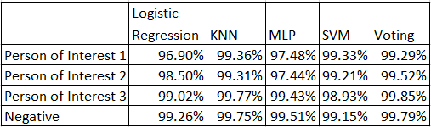
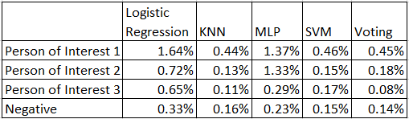
Performance
Accuracy
False Negative

Slide 14
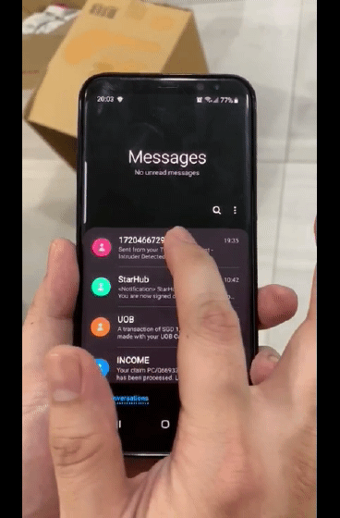
Alert Mechanism – SMS & Email
SMS Alert Using Twilio
Intruder Identified by Face Recognition
Alert SMS Issued
Email with Picture Attachment
Audit Trail
Email Alert Using UiPath
SMS Alert of Intruder
Notes:
Purpose of Alert Mechanism
SMS: Project members to quickly attend to the intruder(s) i.e., take action to stop the intruder(s)
Email: Generate Incident Report to the project team & Management i.e., After-Action Review
Trigger Condition
1. “Unkown” label generated by face recognition
Twilio
Communication API for SMS
It works in the background to bridge the gap between web-based applications and telephones
Application-initiated event - initiated via Twilio's public REST API
In our case, our python script send an HTTP request to Twilio’s API to send a text message from the application's phone number to a recipient phone number, with a message containing the alert
UiPath
Python Activities Pack – enable invoking Python scripts and methods in UiPath workflow (i.e., pass input arguments to Python, retrieve output generated by activities)
Python Scope: container activity that connects to Python environment enabling us to use the rest of the activities within itself
Use “Load Python Script” activity to assign code from Python script file to a PythonObject that can run script, invoke Python methods
Send email with attachment:
Configure “Port and Server” in the Properties of “Send SMTP Mail Message”
Create variables “Email and Password” to store email id and password
Use “Send SMTP Mail Message” activity with “Attach PDF” to attach file
Click on “Attach PDF” to write path of attached file
SMTP – Simple Mail Transfer Protocol used to transmit messages from source to destination
Audit Logs: time-stamped files containing informational events of actions performed by all entities in Orchestrator

Slide 15
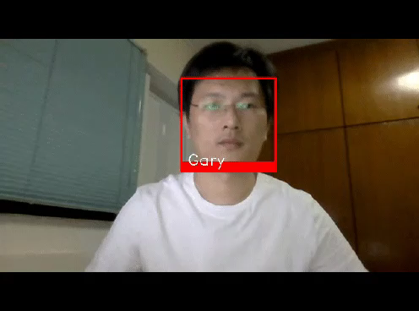
Solution Overview – A Quick Demo
When an intruder enters the prohibited zone, camera 1 detects the presence and initiates the process for camera 2 to start the face recognition.
The face recognition algorithm determines whether the person is an authorized employee. If yes, his presence is logged in the audit trail. If not, then alert activation will take place.
Alert will be sent via email with attachment of intruder’s picture. An SMS will be sent to a stakeholder. Also, the incident will be logged.

Slide 16
Project Plan

Slide 17
Appendix

Slide 18
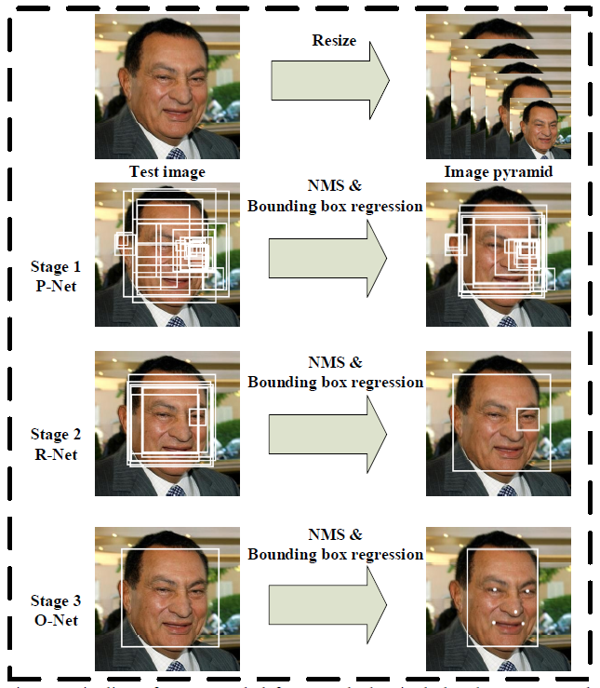
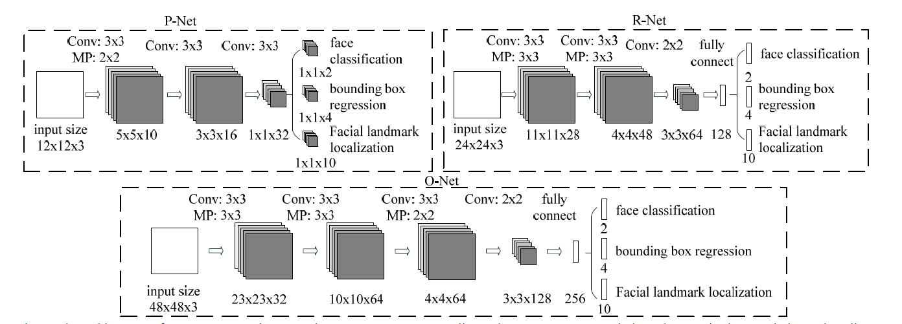
MTCNN - Explained
MTCNN 3 Networks
Image is rescaled to a range of different sizes (Image Pyramid)
P-Net model (Proposal Network) proposes candidate facial regions
R-Net model (Refine Network) filters the bounding boxes
O-Net model (Output Network) proposes facial landmarks
MTCNN 3 Tasks
Face classification
True/False
Bounding box regression
Left, Top, Width, Height
Facial landmark localization
5 Points (Left / Right Eye, Nose, Left / Right Mouth Corner)

Slide 19

Demo Asset – Currently Under Construction
The surveillance camera will be incorporated as part of the Smart City Demo Asset. It will serve several functions:
Intruder Detection
Face Recognition based on Person of Interest
Alert mechanism

Slide 20
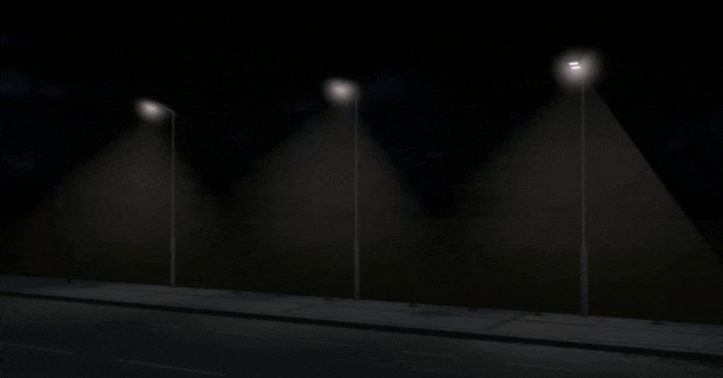
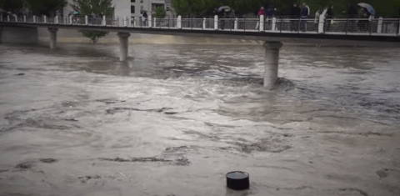
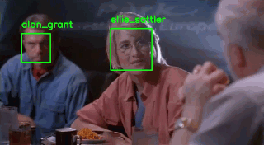
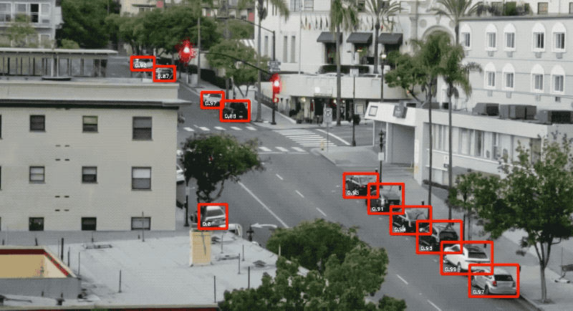
Smart City Demo
Oracle Cloud
2
1
8
Smart
Street Lighting
Flood Control
Smart
Pedestrian Crossing
3
6
Person of Interest Recognition
Reserved
4
5
7
Smart
Traffic Lighting
Smart Parking
Car License Plate Recognition

